Slide 1
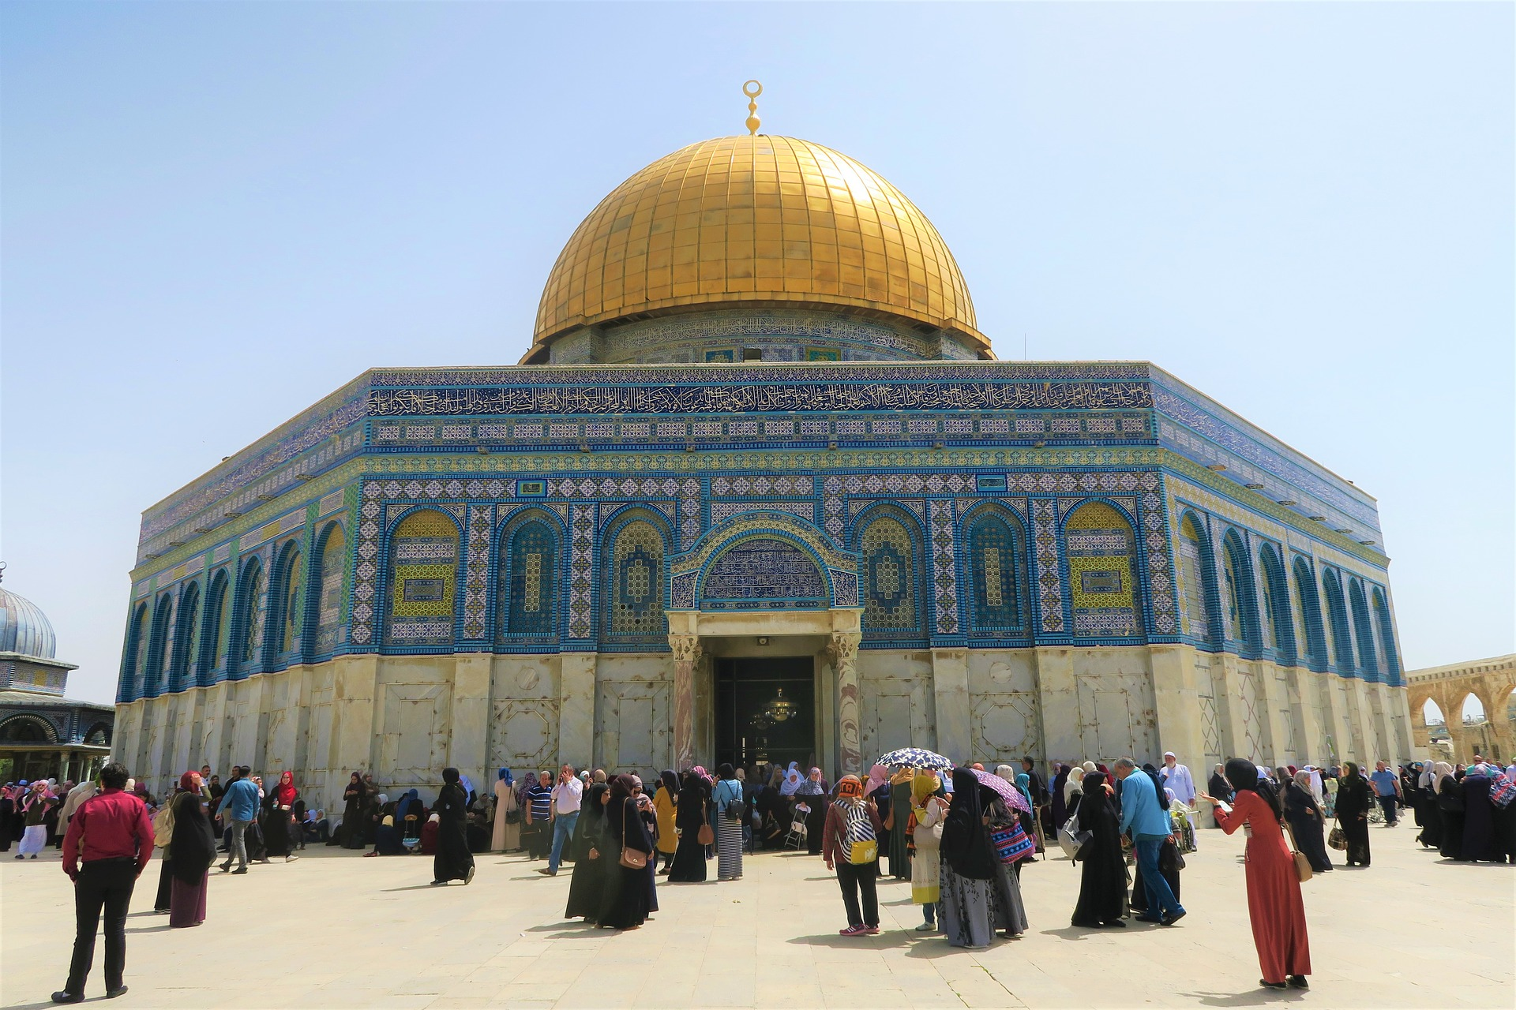
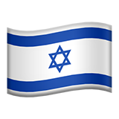
Israel

Slide 2
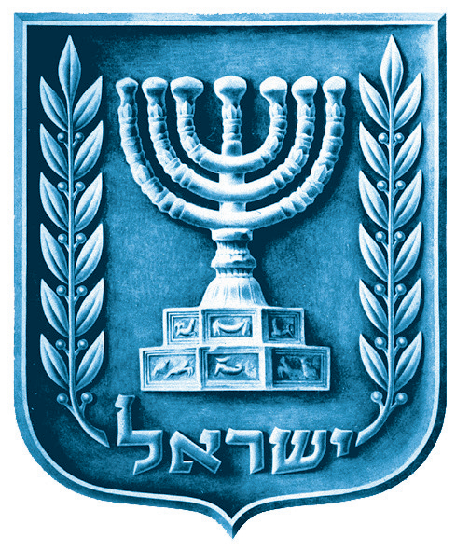
Introduction
Israel is a small Middle Eastern country on the eastern Mediterranean Sea, bordered by Lebanon, Syria, Jordan, Egypt, and the Mediterranean. Its proclaimed capital is Jerusalem, though it is not widely recognized internationally, while Tel Aviv is the largest urban area and economic center.
Israel, within its internationally recognized borders, features a coastal plain, northern and central highlands, the Negev Desert in the south, and the Great Rift Valley along its eastern edge.

Slide 3
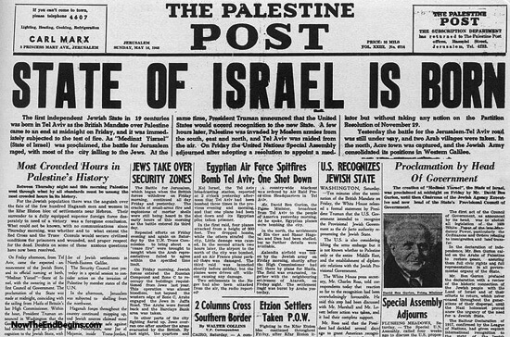
History of Israel
Israel was established on May 14, 1948, after the UN Partition Plan (1947) proposed dividing British-ruled Palestine into Jewish and Arab states. Upon declaration, Israel faced immediate invasion by neighboring Arab countries, leading to the 1948 Arab-Israeli War.
Despite the conflict, Israel survived and secured its statehood, marking the beginning of a new era for Jews worldwide.

Slide 4
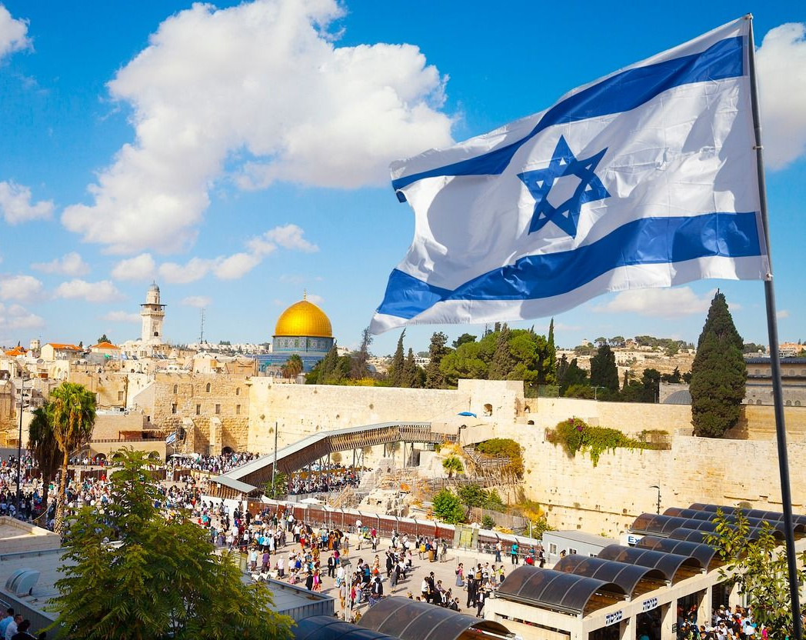
History of Israel
The modern state of Israel is the world’s first Jewish nation in two millennia, symbolizing the return of Jews to their ancestral homeland after the Diaspora that began with the fall of the Herodian kingdom in the 1st century CE.
It remains a central destination for Jewish immigration from around the world.

Slide 5
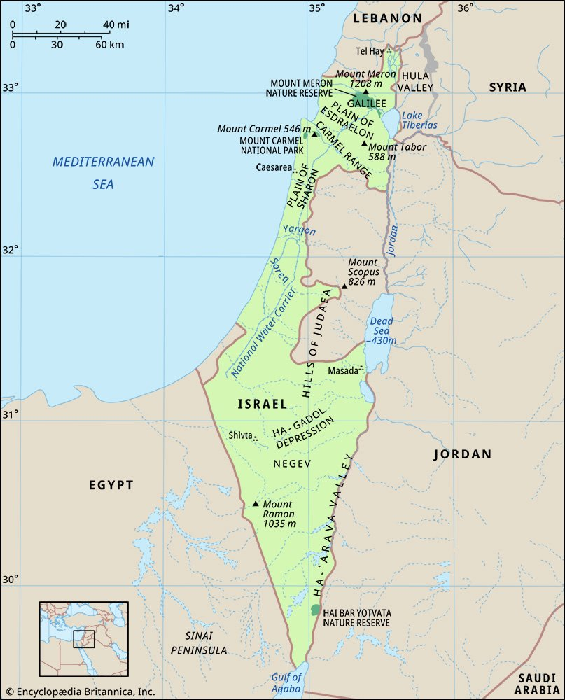
History of Israel
Despite its small size—about 290 miles long and 85 miles wide—Israel features four main geographic regions: the Mediterranean coastal plain, the central hill region, the Great Rift Valley, and the Negev Desert.
The coastal plain stretches about 115 miles along the Mediterranean, with sandy beaches, fertile farmland, and major urban centers like Tel Aviv and Haifa. Inland, the hill regions include forests and mountains, while the Rift Valley forms part of a major geological fault line. In the south lies the arid Negev, covering over half the country’s land with desert landscapes and unique ecosystems.

Slide 6
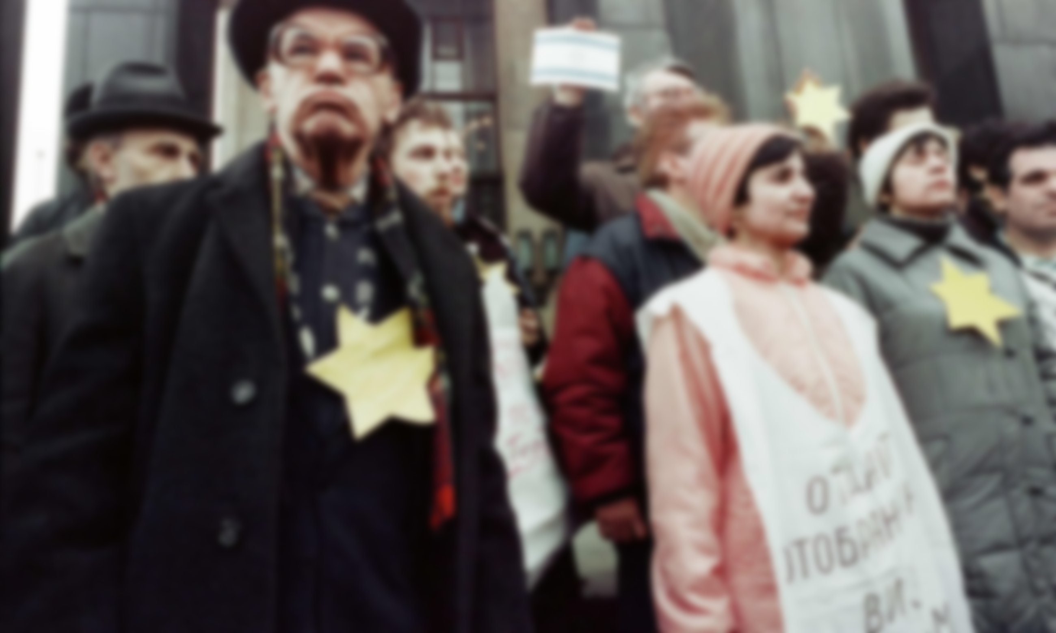
History of Israel
The most significant demographic issue in Israel has been Jewish immigration. In 1948, the Jewish population was about 670,000, rising to over 1 million by 1949 due to mass immigration.
Between 1949 and 1997, about 2.35 million Jews immigrated to Israel, including over 320,000 Soviet Jews (1989–91) and nearly 28,000 Ethiopian Jews (1990–92). By 2020, the Ethiopian Jewish population had reached nearly 150,000. Most Jewish Israelis trace their roots to Europe, North America, North Africa, Asia, and the Middle East.

Slide 7
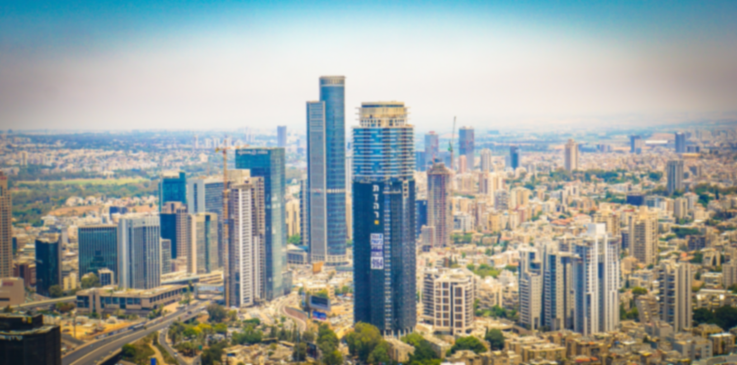
Economy of Israel
After 1948, Israel’s GNP rose rapidly due to skilled immigrants, the founding of universities, and major capital inflows from global Jewish communities, German reparations, U.S. aid, and private investment.
Despite challenges like rapid population growth, regional boycotts, defense costs, and limited resources, Israel built a strong economy with high living standards, thriving technology, and export sectors. Economic divisions persist, particularly among Israeli Arabs and between Sephardic and Ashkenazi Jews.

Slide 8

Economy of Israel
While privatization has grown since the late 1970s, government and private sectors coexist. Israel has high tax rates, with major reforms in 1985.
Histadrut, once a major employer, now mainly acts as a labor union, alongside employer groups like the Manufacturers’ Association and Farmers’ Union.

Slide 9
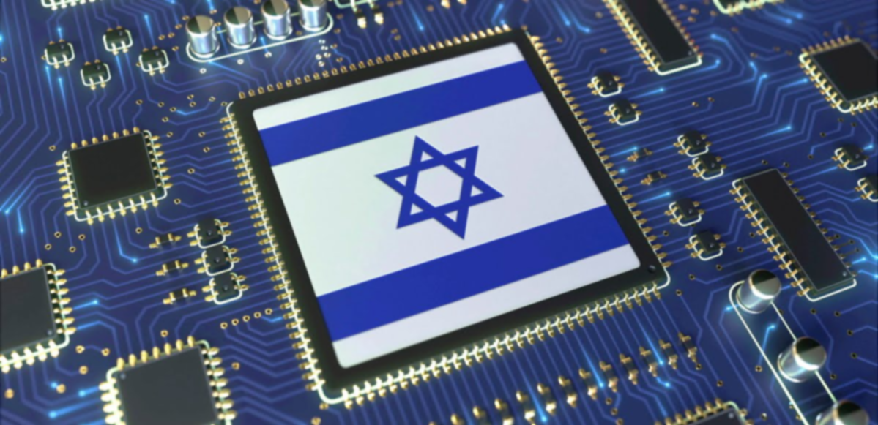
Economy of Israel
Key Features of Israel's Economy:
Innovation & Technology
Known as the "Start-Up Nation", Israel has a vibrant tech sector.
Major strengths in cybersecurity, AI, medical tech, and software.
Home to global R&D centers of companies like Google, Microsoft, Intel.
GDP & Economic Strength
High-income economy with a GDP (2023) of approx. $525 billion USD.
Strong per capita GDP (over $50,000), comparable to many Western countries.

Slide 10
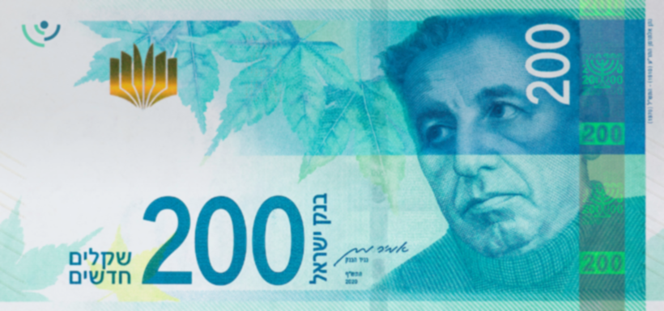
Economy of Israel
Key Features of Israel's Economy:
Natural Resources
Historically resource-scarce, but recent discoveries of offshore natural gas fields (Tamar and Leviathan) have boosted energy independence.
Currency & Central Bank
Currency: Israeli New Shekel (ILS).
The Bank of Israel manages monetary policy and inflation.

Slide 11
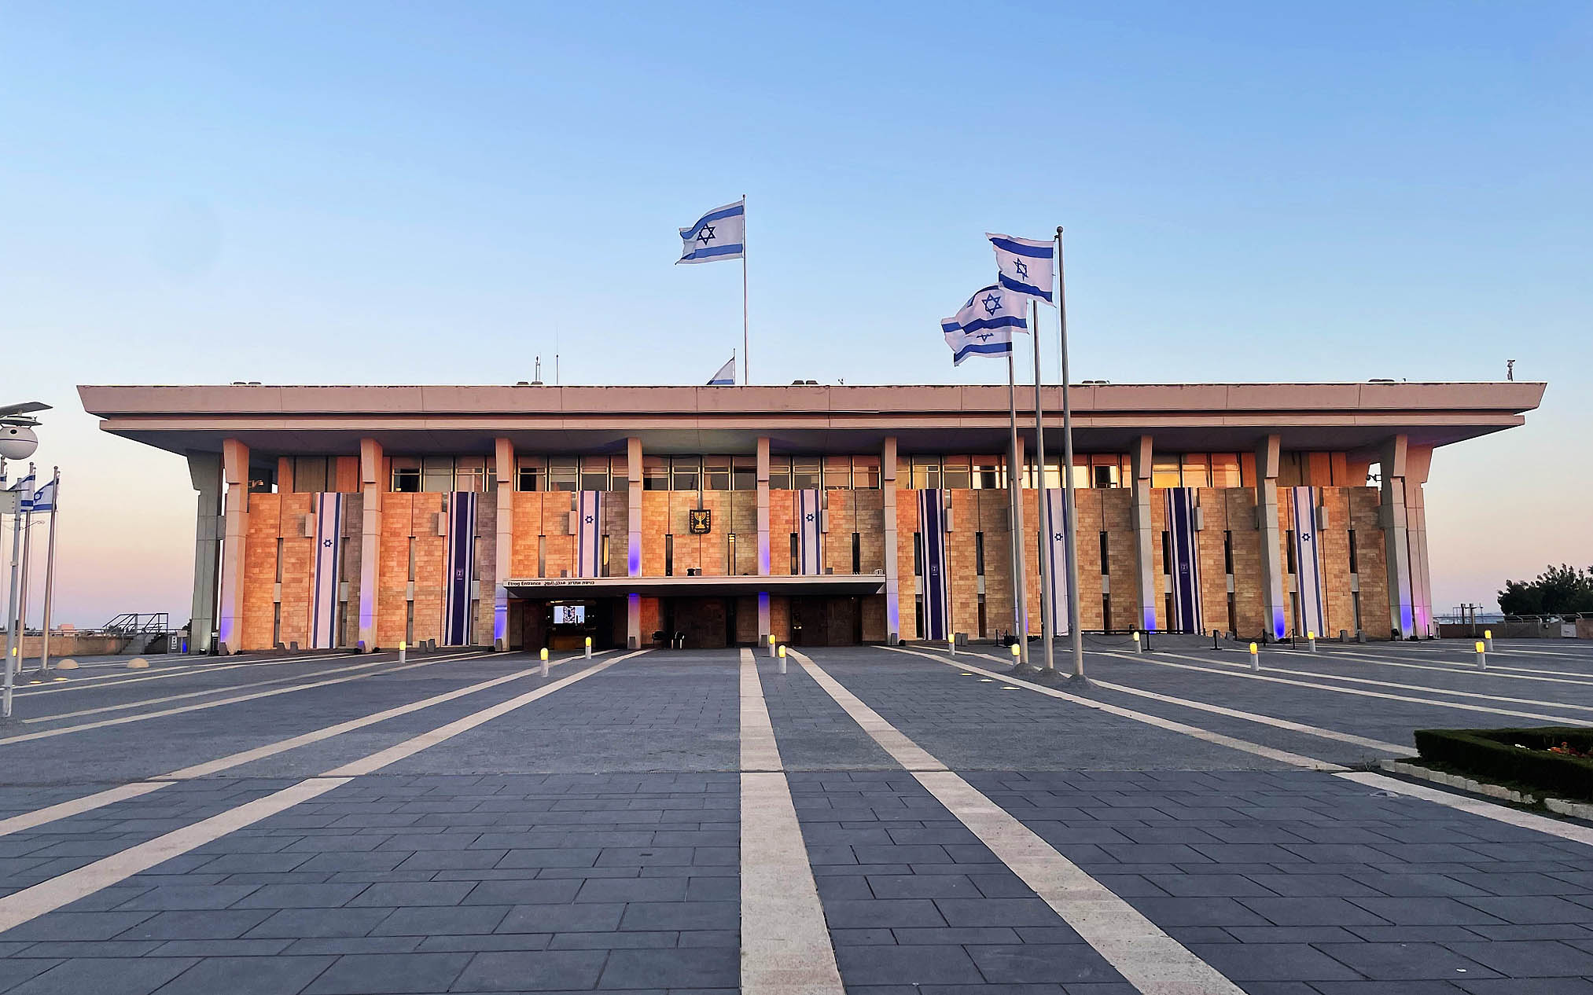
Government and society
Constitutional framework:
Israel has no formal constitution but is governed by “basic laws,” legislation, executive orders, and parliamentary practices. It is a democratic republic with a parliamentary system led by a prime minister and many political parties. The Knesset, Israel’s single-chamber legislature with 120 members, is elected every four years. Hebrew is the official language, and Arabic holds special status.

Slide 12
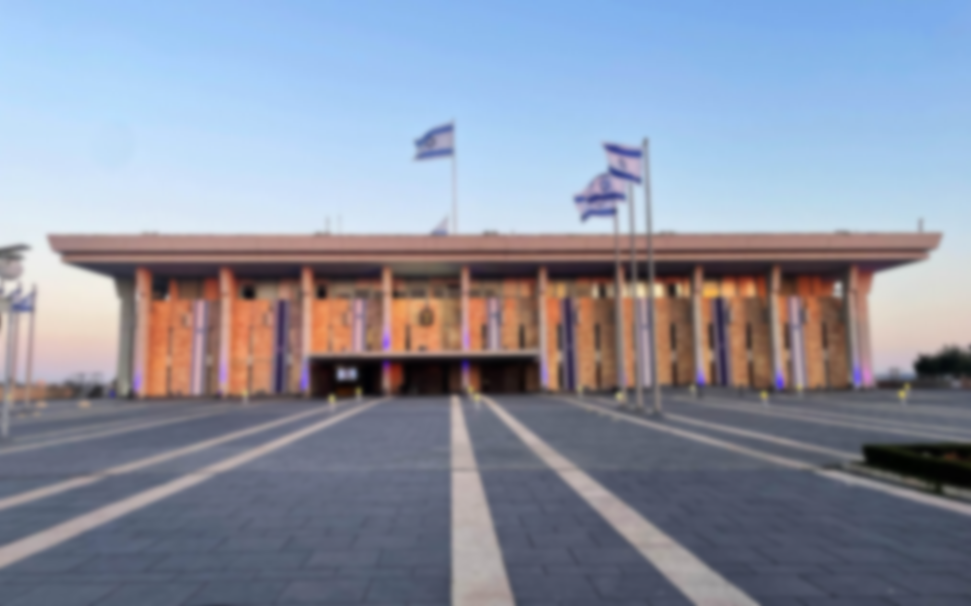
Political system of Israel
The political system of Israel is a parliamentary democracy, characterized by a multi-party system, a separation of powers, and a written set of basic laws that act as a de facto constitution.
1. Legislature – The Knesset
Unicameral (one-chamber) national legislature.
Consists of 120 members elected for 4-year terms via proportional representation.
Threshold: A party must receive at least 3.25% of the national vote to enter the Knesset.
Responsibilities: Passes laws, supervises government actions, approves the budget, and can dissolve itself to trigger new elections.

Slide 13
Political system of Israel
2. Executive – President and Prime Minister
President of Israel:
Ceremonial head of state with limited powers.
Elected by the Knesset for a single 7-year term.
Performs symbolic duties, appoints the Prime Minister based on election outcomes, and grants pardons.
Prime Minister:
Head of government with real executive power.
Typically, the leader of the largest party or coalition in the Knesset.
Appointed formally by the President but must gain Knesset confidence.
Leads the cabinet (government) and makes policy decisions.

Slide 14
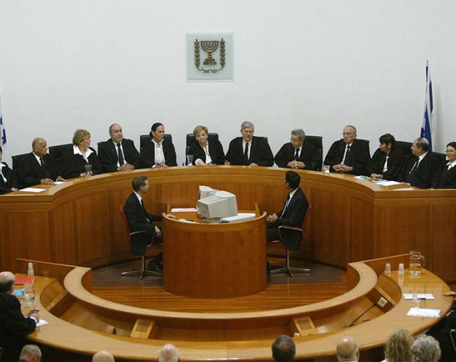
Political system of Israel
3. Judiciary – Independent and Powerful
Headed by the Supreme Court of Israel.
Justices are appointed by a Judicial Selection Committee.
Has the power of judicial review over laws and government actions.
Upholds civil liberties, minority rights, and enforces basic laws.

Slide 15
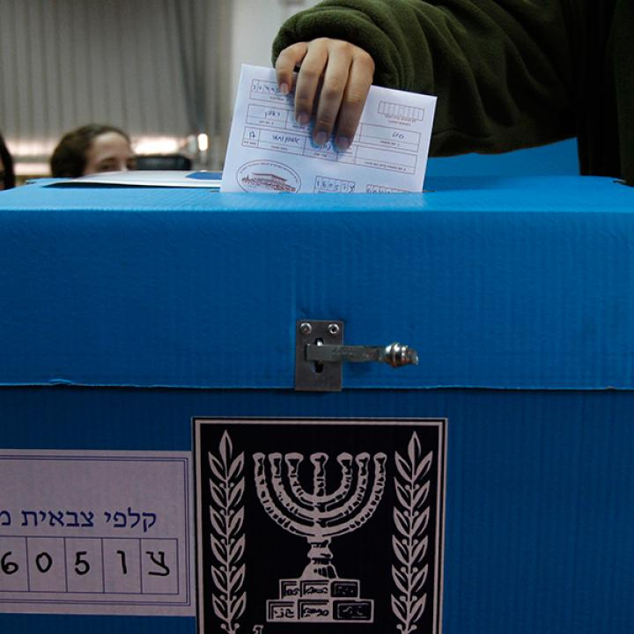
Political system of Israel
4. Electoral System
Nationwide proportional representation with no electoral districts.
Voters cast ballots for political parties, not individual candidates.
Coalition governments are common due to the large number of parties.

Slide 16
Political system of Israel
Political Dynamics
Often shaped by coalition politics, requiring alliances among parties (including religious, secular, Arab, and nationalist parties).
Major parties include:
Likud (right-wing, nationalist)
Yesh Atid (centrist, secular)
Blue and White, Labor, Shas, United Torah Judaism, Joint List, Religious Zionist Party, etc.

Slide 17
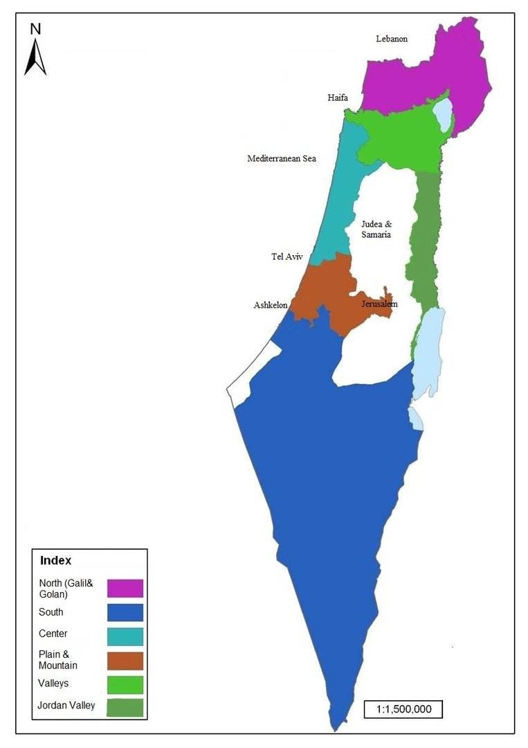
Political system of Israel
Local and regional government
The country is divided into 6 districts—Central, Jerusalem, Haifa, Northern, Southern, and Tel Aviv—and into 15 subdistricts. Local government consists of municipalities, local councils (for smaller settlements), or regional rural councils.
The bylaws of the councils, as well as their budgets, are subject to approval by the Ministry of the Interior. Local government elections are held every five years.

Slide 18
Political process
Israeli elections are held by universal suffrage and secret ballot, with citizens voting from age 18. The Knesset is elected by proportional representation, leading to a complex party system and coalition governments. Electoral reforms in 1992 briefly introduced direct prime ministerial elections, but this was repealed in 2001.
New parties, often centered around prominent leaders, have since challenged the traditional dominance of Labour and Likud. Parties are typically secular Zionist or religious, and Arab parties gained strength by uniting as the Joint List in 2015. Civic participation in public affairs is widespread.

Slide 19
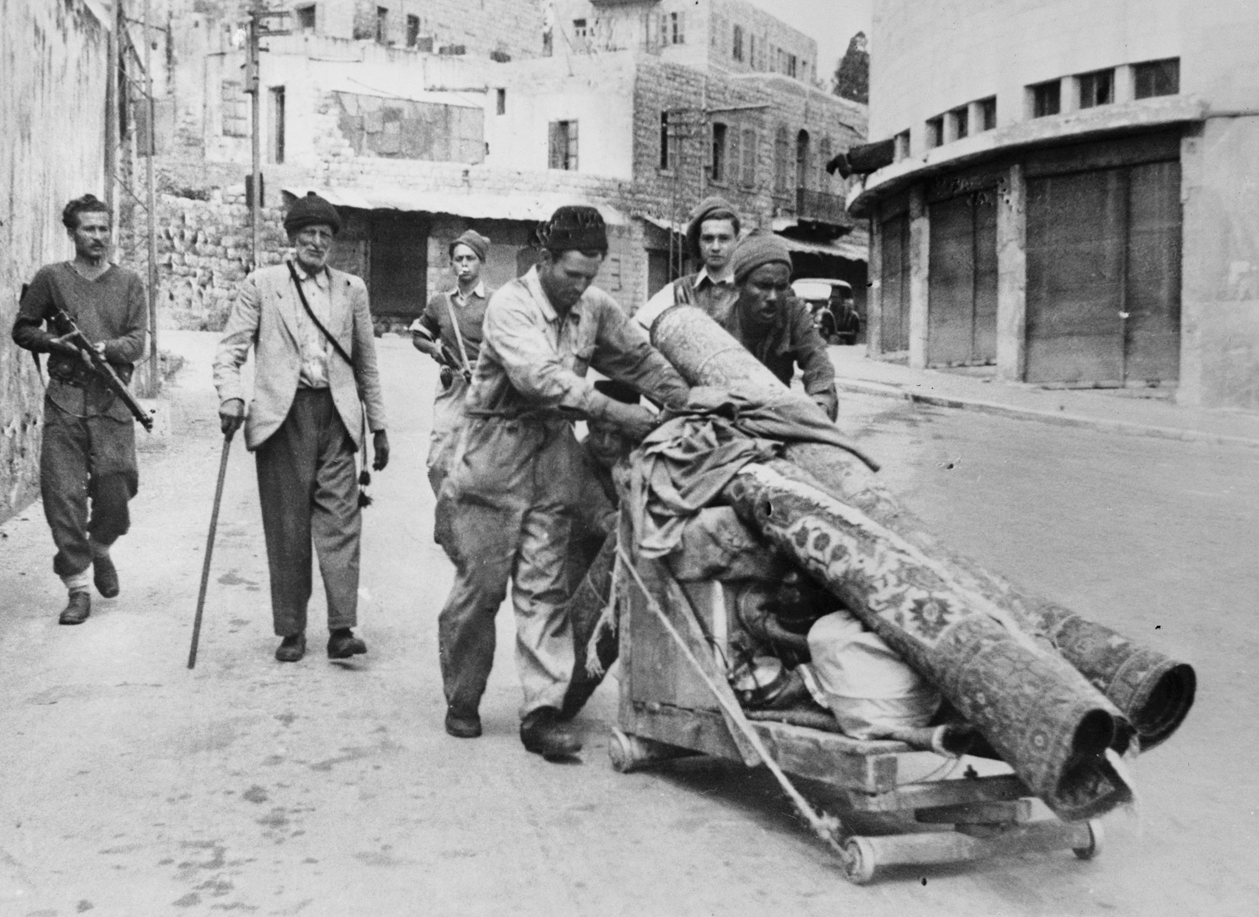
Major Wars
1948 Arab-Israeli War (War of Independence / Nakba)
Date: 1948–1949
Began after Israel declared independence.
Fought between Israel and a coalition of Arab states (Egypt, Jordan, Syria, Iraq, Lebanon).
Israel survived and expanded its territory beyond the UN Partition Plan.
About 700,000 Palestinian Arabs became refugees.

Slide 20
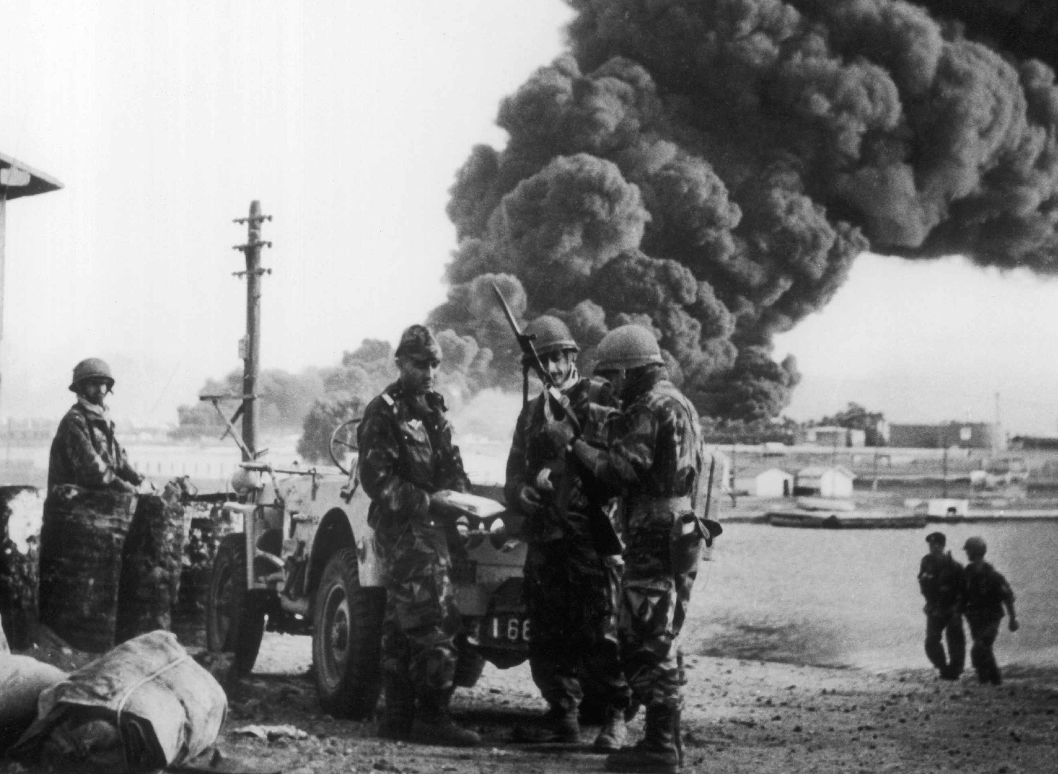
Major Wars
1956 Suez Crisis (Second Arab-Israeli War)
Date: October–November 1956
Triggered by Egypt’s nationalization of the Suez Canal.
Israel, Britain, and France attacked Egypt.
Israel invaded the Sinai Peninsula but later withdrew under U.S. and UN pressure.

Slide 21
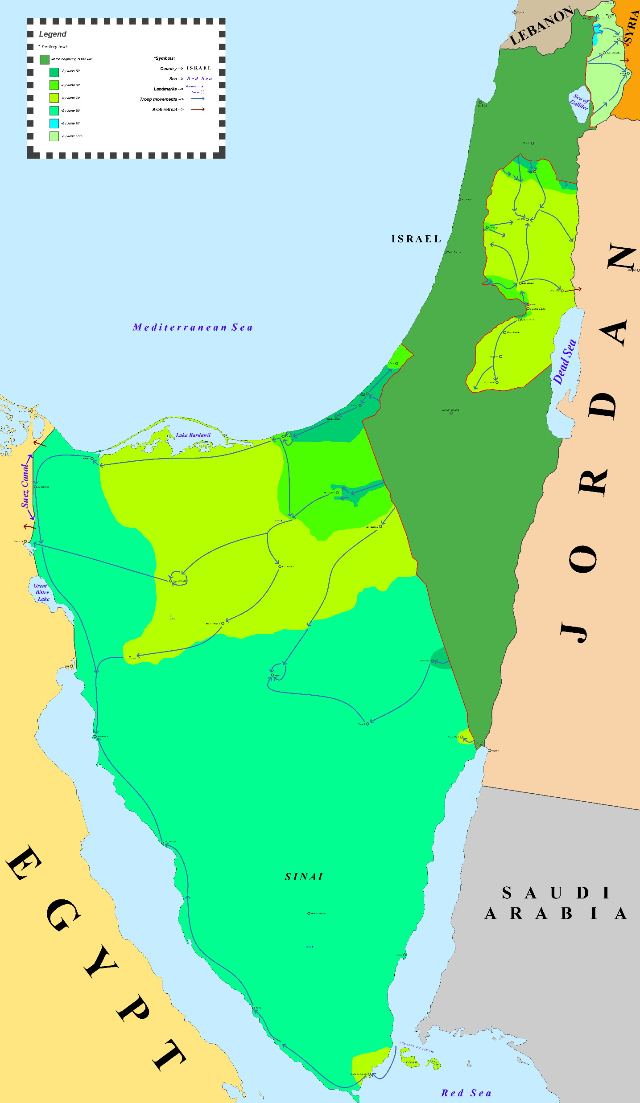
Major Wars
1967 Six-Day War
Date: June 5–10, 1967
Israel pre-emptively struck Egypt, Syria, and Jordan.
Achieved a swift victory.
Captured Sinai Peninsula, Gaza Strip, West Bank, East Jerusalem, and Golan Heights.

Slide 22
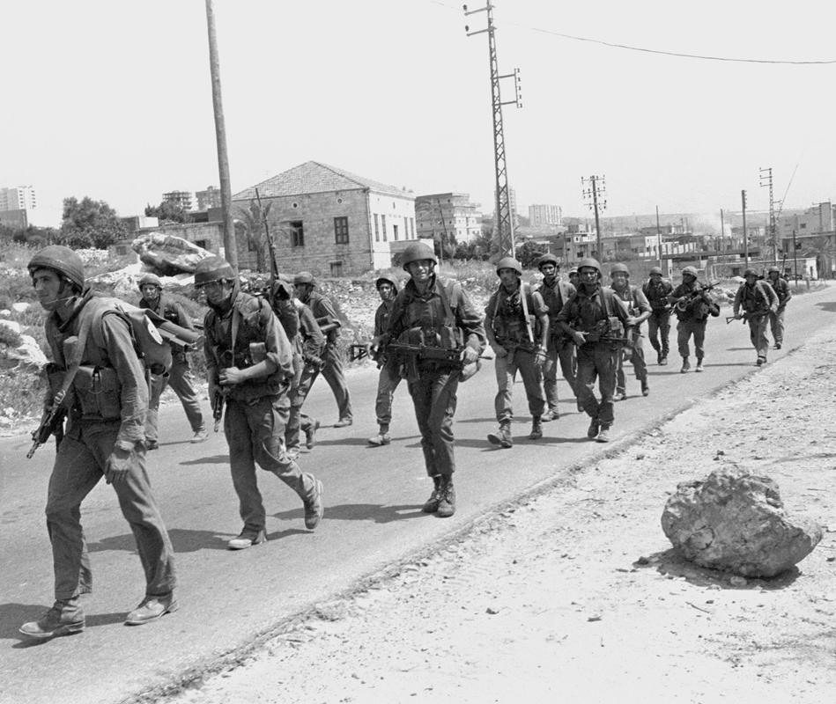
Major Wars
1982 Lebanon War (Operation Peace for Galilee)
Date: 1982–1985 (with ongoing involvement until 2000)
Israel invaded southern Lebanon to expel the PLO.
Led to prolonged Israeli occupation of southern Lebanon.
Rise of Hezbollah as a resistance movement.

Slide 23
Major Wars
Gaza Wars / Operations
Israel has fought multiple conflicts with Hamas in the Gaza Strip:
2008–09 (Operation Cast Lead)
2012 (Operation Pillar of Defense)
2014 (Operation Protective Edge)
2021 (Guardian of the Walls)
2023–24 War (after October 7 Hamas attack) – most devastating Gaza war to date.

Slide 24
Thank You
תודה לך

